Slide 1
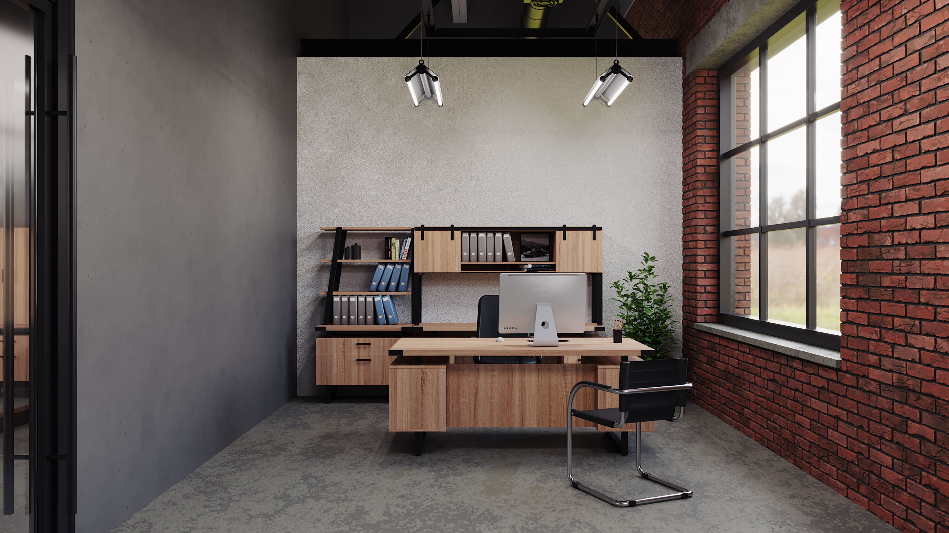

Realty One
December 2021
Sherry L. Schrank
Furniture Program Manager | Catalog
Workspace Interiors by Office Depot

Slide 2

Outfitting your office just got simpler.
From creating a more efficient workspace to choosing furniture that reflects your personal style, we offer a complete service solution that’s equipped to handle all your business and home office furniture needs.

Slide 3
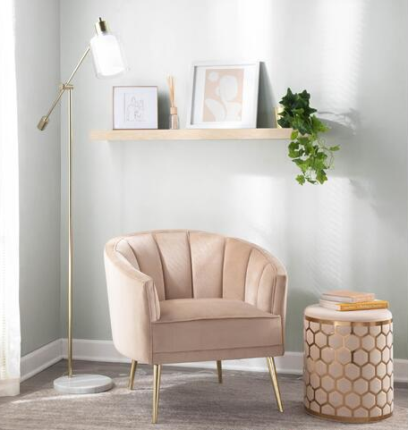
Seating

Slide 4
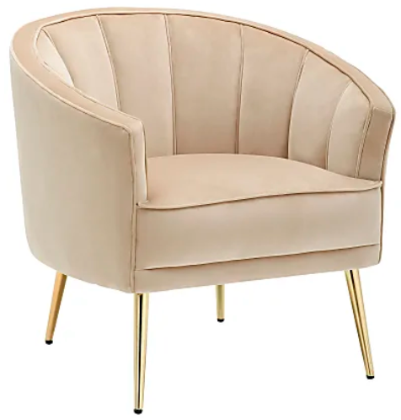
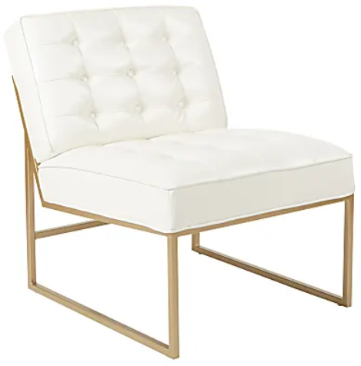
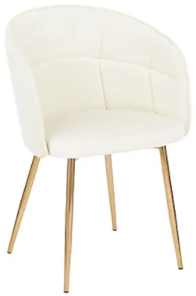
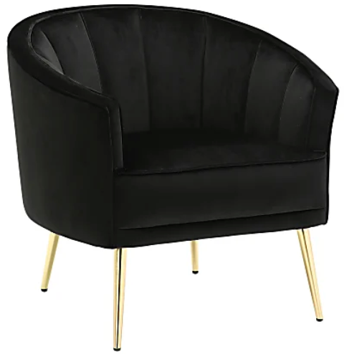
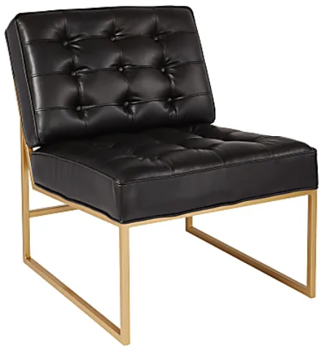
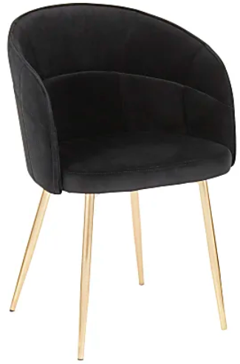


Workspace | Reception
LumiSource Tania Accent Chair
Office Star™ Avenue Six Work Smart™
Anthony Chair
LumiSource Lindsey Chair
Metal legs
Mid back
Padded seat
Velvet upholstery
Padded armrests
Assembly required
Overall Dimensions: 29”H x 30”W x 27”D
Weight capacity tested to support 250 lbs.
Product # 8582381 | Champagne/Gold
Product # 8582381 | Black/Gold
Polyurethane seat and bonded leather back
Creates a comfortable sitting area
Strong metal frame with a beautiful, powder-coated finish
Durable fabric and sturdy powder-coated metal frame
Button-tufted seat & back add a touch of modern style
Assembly required
Overall Dimensions: 32 1/2"H x 27"W x 33"D
Weight capacity tested to support 250 lbs.
Product # 6666122 | White/Gold
Product # 7698053 | Black/Gold
This chic chair complements a variety of spaces
Padded seat and backrest with stylish tufting
Velvet upholstery
Metal frame
Glam/contemporary styling
Assembly required
Overall Dimensions: 32"H x 22-1/2"W x 20-1/2"D
Weight capacity tested to support 250 lbs.
Product # 4297005 | Cream/Gold
Product # 6114118 | Black/Gold

Slide 5
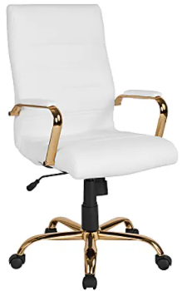
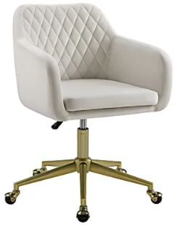
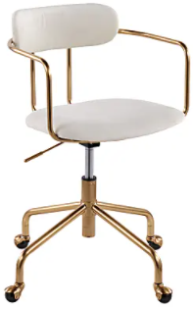
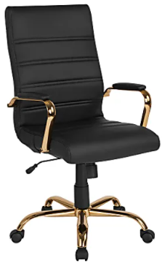
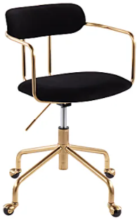
Workspace | Task
Flash Furniture LeatherSoft Office Chair
Linon Inman Quilted Fabric Mid-Back Office Chair
LumiSource Demi Mid-Back Office Chair
LeatherSoft faux leather office chair
Waterfall seat with lumbar support
Tilt tension and tilt lock adjustments
360° swivel on 5-star gold chrome base
5-star chrome base with dual-wheel casters.
Assembly required
Overall Dimensions: 43"H x 26"W x 27"D
Weight capacity tested to support 250 lbs.
Product # 8904228 | White/Gold | High-Back
Product # 4500085 | White/Gold | Mid-Back
Product # 9721586 | Black/Gold | High-Back
Product # 8980034 | Black/Gold | Mid-Back
Padded seat with fabric upholstery
Quilted pattern on the backrest
Seat adjusts from 17" to 21" in height
Contoured armrests
Smooth-rolling casters
Recommended for performance use 6-8 hours per day
Overall Dimensions: 34-3/4"H x 23-1/4"W x 23-3/4"D
Weight capacity tested to support 300 lbs.
Product # 8537426 | Off-White/Gold
Velvet-upholstered desk chair
Waterfall seat
Seat height adjustments
Arched armrests
360° swivel on rolling casters
Assembly required
Overall Dimensions: 34”H x 25”W x 25”D
Weight capacity tested to support 250 lbs.
Product # 9258368 | Cream/Gold
Product # 6976573 | Black/Gold

Slide 6
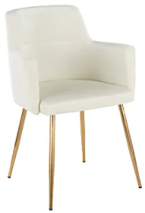
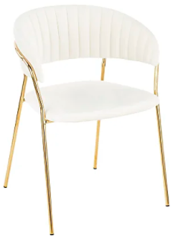
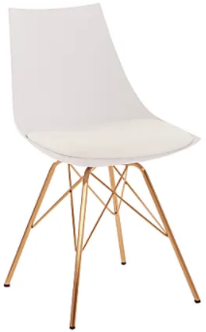
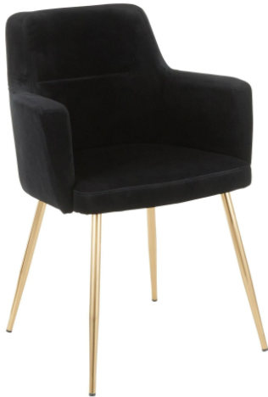
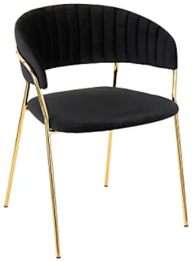
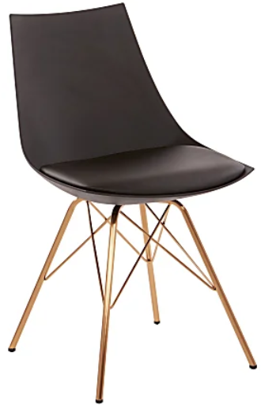
Workspace | Guest
Linon Inman Quilted Fabric Mid-Back Office Chair
LumiSource Tania Chairs
Office Star™ Avenue Six Oakley Chair
Padded seat with fabric upholstery
Quilted pattern on the backrest
Seat adjusts from 17" to 21" in height
Contoured armrests
Smooth-rolling casters
Recommended for performance use 6-8 hours per day
Weight capacity tested to support 300 lbs.
Overall Dimensions: 34-3/4"H x 23-1/4"W x 23-3/4"D
Product # 4544379 | Off-White/Gold | Set of 2 Chairs
Product # 3834273 | Black/Gold | Set of 2 Chairs
Stylish accent side chairs
Unique design that is sure to get visitors talking
Velvet upholstery with pleated backrests
Velvet upholstery creates a soft and smooth seat
Sleek metal frames
Assembly required
Overall Dimensions: 30"H x 22-1/2"W x 22"D
Weight capacity tested to support 250 lbs.
Product # 4572747 | White/Gold | Set of 2 Chairs
Product # 8242176 | Black/Gold | Set of 2 Chairs
Modern style that's sure to attract notice
Padded seat provides a soft, cushioned feel
Bonded leather upholstery offers a touchable feel
Classic appearance that suits almost any environment
Metallic base adds an attractive accent
Assembly required
Overall Dimensions: 32 3/4"H x 18 1/2"W x 20 3/4"D.
Weight capacity tested to support 200 lbs.
Product # 4172148 | White/Gold
Product # 6976573 | Black/Gold

Slide 7
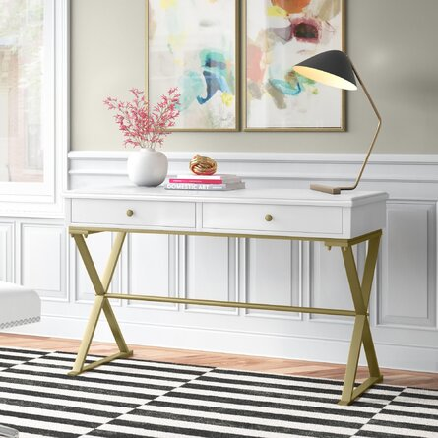
Desking

Slide 8
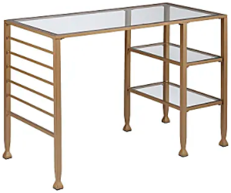
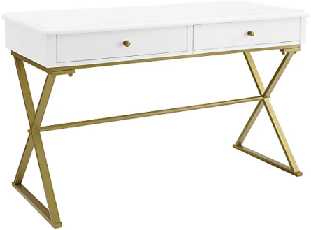
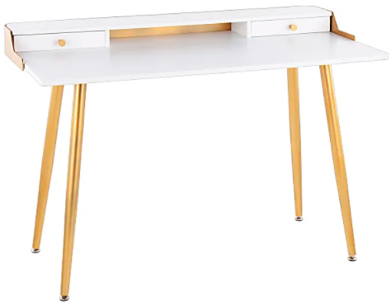
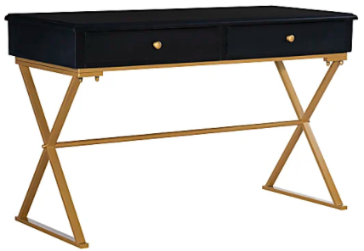
Workspace | Desks
Southern Enterprises Jaymes
43"W Writing Desk
Linon Home Decor Products Amy Campaign
48"W Writing Desk
LumiSource Harvey
48"W Writing Desk
Unique storage space and a transitional style
Strong iron frame is built for durability
Tempered glass desktop provides a modern touch
2 fixed shelves and 6 storage rails
Shelves are weight tested to support 20 lbs. each
Top is weight capacity tested to support 40 lbs.
Assembly required
Overall Dimensions: 30-1/4”H X 42-3/4”W X 20-3/4”D
Product # 7443161 | Soft Gold
Unique style with storage
Gold finish hardware
"X" styled matte gold legs
One storage drawer
Weight capacity: 100 lbs.
Interior drawer: 19.75"W x 15.125"D x 3.5"H
Floor to base of desk: 23" H
Overall Dimensions: 29”H X 47-1/4”W X 19-5/8”D
Product # 6276801 | White/Gold
Product # 7263680 | Black/Gold
Mid-century modern desk with tapered legs
Wooden construction wood-top desk
Storage to keep your essentials close
Contemporary styling with a sophisticated touch
2 pull-out drawers
1 open shelf
Assembly required
Overall Dimensions: 33”H X 47-1/2”W X 23-3/4”D
Product # 5441582 | White/Gold

Slide 9
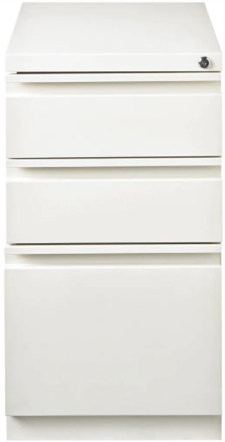
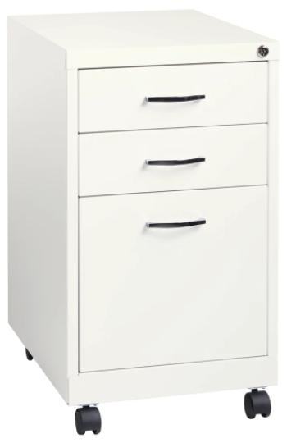
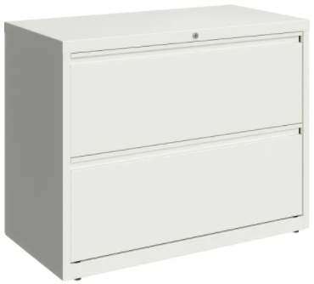
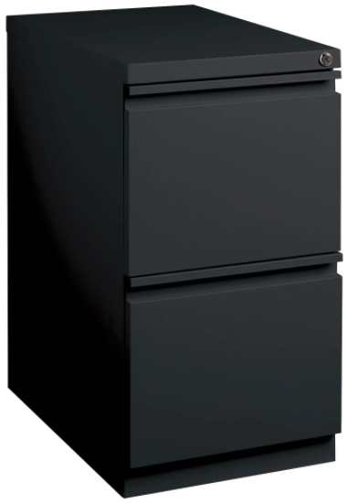
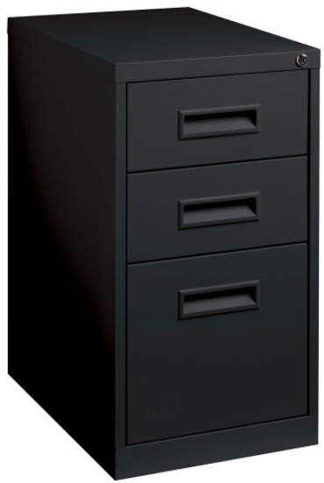
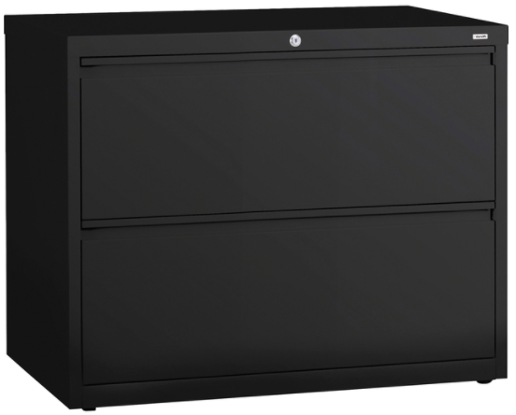
Workspace | Files
Lorell® Mobile File Pedestal Cabinet
Lorell® Mobile Pedestal File Cabinet
Lorell 36"W 2-Drawer Lateral File Cabinet
Steel, ball-bearing suspension for smooth opening/closing
Counterweight to guard against tipping
Hidden casters for a clean, professional look
Full-drawer extension for complete access
Core-removable lock to secure your letter-size files
Save time – no assembly required
Overall Dimensions: 27.75”H x 15”W X 19.7”D
Product # 8551329 | 3-Drawer | White
Product # 8551475 | 2-Drawer | White
Product # 783042 | 3-Drawer | Black
Product # 783087 | 3-Drawer | Black
Steel construction provides durability.
Casters allow easy movement
2 swiveling and 2 fixed casters for maneuverability
Ball-bearing suspension promotes smooth performance
High-side drawers provide ample room hanging file folders Includes 2 box drawers and a file drawer
Lock secures all drawers to prevent unauthorized access.
Save time – no assembly required
Product # 877965 | 3-Drawer | White | 19” Deep
Product # 967581 | 3-Drawer | Black | 22” Deep
Heavy-gauge steel construction
Full-width drawer pulls on ball-bearing slide suspension
File rails accommodate letter, legal-or A4-size file folders
Drawers feature magnetic label holders
Core-removable lock and dual locking bars
4 adjustable leveling guides
Meets/exceeds ANSI/BIFMA performance standards.
Save time – no assembly required.
Overall Dimensions: 28”H x 36”W x 18.5”D
Product # 9256656 | White
Product # 233919 | Black

Slide 10
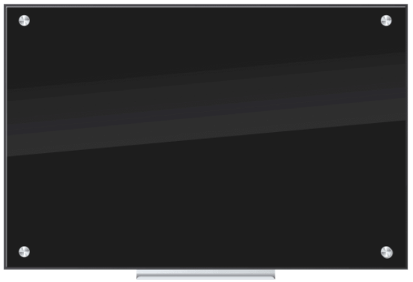
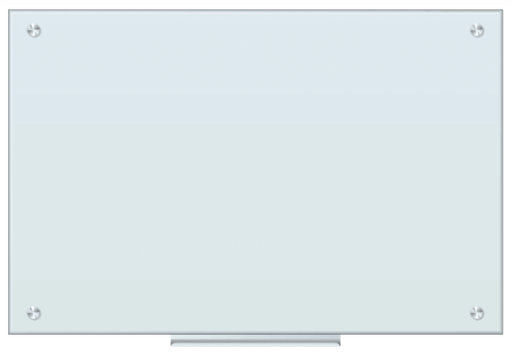
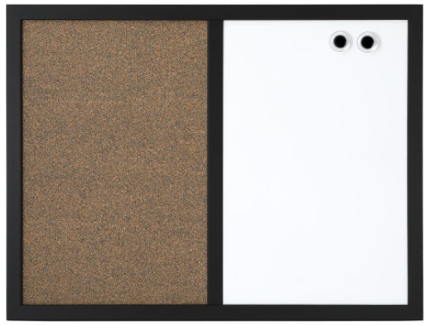
Workspace | Boards
U Brands Frameless Non-Magnetic
Glass Dry Erase Board
U Brands Frameless Non-Magnetic
Glass Dry Erase Board
Realspace™ Magnetic Dry-Erase Whiteboard
& Cork Bulletin Board
Premium tempered black glass dry-erase surface
Never stains or ghosts – add a tough of style to your wall
Black background creates high contrast with any marker
Glass is the highest quality dry-erase surface available
Modern frameless design hides all hanging hardware
Includes hassle-free mounting hardware and instructions
Mounts vertically or horizontally
Product # 9189812 | 36”W x 24”H | Black
Product # 3589323 | 48”W x 36”H | Black
Product # 9313212 | 72”W x 48”H | Black
Product # 8634632 | 96”W x 48”H | Black
Premium tempered white frosted glass dry-erase surface
Never stains or ghosts – add a tough of style to your wall
White background creates high contrast with any marker
Glass is the highest quality dry-erase surface available
Modern frameless design hides all hanging hardware
Includes hassle-free mounting hardware and instructions
Mounts vertically or horizontally
Product # 6610751 | 36”W x 24”H | Frosted White
Product # 4634103 | 48”W x 36”H | Frosted White
Product # 6191629 | 72”W x 48”H | Frosted White
Product # 9964730 | 96”W x 48”H | Frosted White
Magnetic steel dry-erase board offers smooth writing
Cork bulletin board provides a space to hang important notices and memos with pushpins
Magnetic surface can be used to post items that you reference regularly
Wood frame provides durability and a sleek appearance
Comes with 2 magnets and mounting hardware
Product # 186107 | 24”W x 18”H | Black/White/Cork
Product # 328527 | 36”W x 24”H | Black/White/Cork

Slide 11
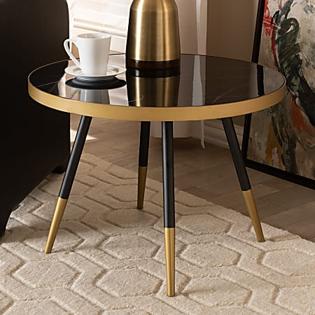
Tables

Slide 12
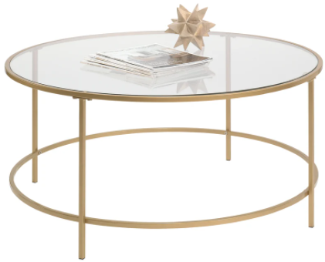
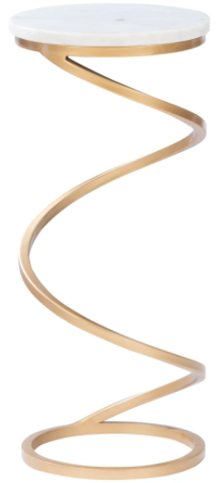
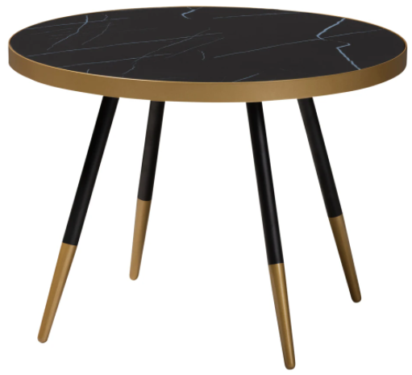
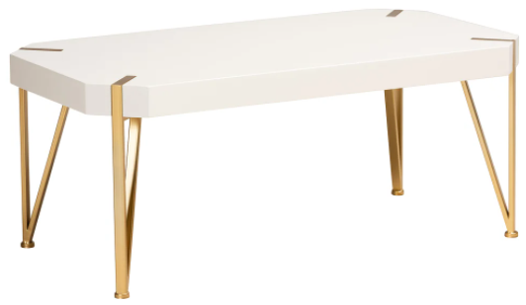
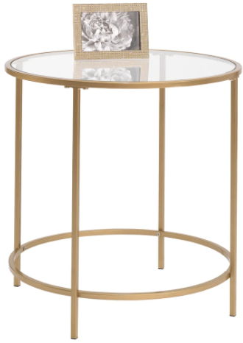
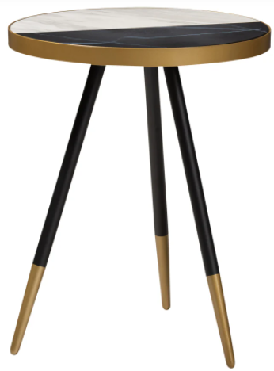
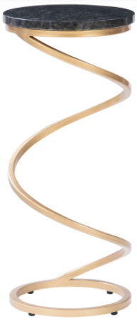
Workspace | Reception
Sauder® International Lux Tables
Baxton Studio Modern Table
Baxton Studio Contemporary Glam & Luxe Table
& Powell Thayer Metal Drink Side Table
Modern furniture with no boundaries
Great for living or lobby office spaces
Uniquely combines mixed materials
Eclectic design
Metal frame
Open architecture
Assembly required
Dimensions: 16.5”H Coffee | 22”H Side
Product # 127668 | Satin Gold | 36” Round Coffee
Product # 710933 | Satin Gold | 22” Round Side
Elegant design adds plenty of style to your décor
Sturdy iron base ensures it can withstand plenty of use
Display magazines, plants and other items
Durable iron frame
Marble MDF tabletop
Angled legs
Assembly required
Dimensions: 16.5”H Coffee | 21.75”H Side
Product # 9802746 | Black/Gold/Marble | 24” Round Coffee
Product # 9651902 | Black/Gold/Marble | 18” Round Side
Blend of metal engineered wood and/or stone
Creates an aesthetic upscale taste in décor
Keep important items within reach for your guests
Iron base construction for strength and durability
Angled legs on coffee table, sculptural design on side table
Levelers under the base provide stability
Overall Dimensions: 18”H x 43.5”W x 23”D | Coffee
Overall Dimensions: 23.75”H x 10.5”W x 10.5”D | Side
Product # 6078891 | White/Gold | Coffee
Product # 9068990 | White/Gold | Side
Product # 5122380 | Black/Gold | Side

Slide 13
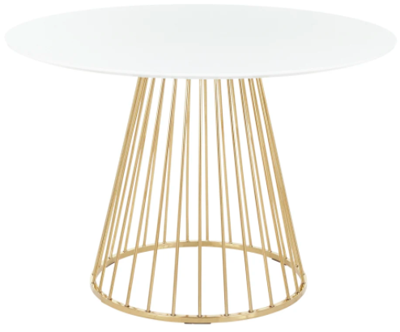
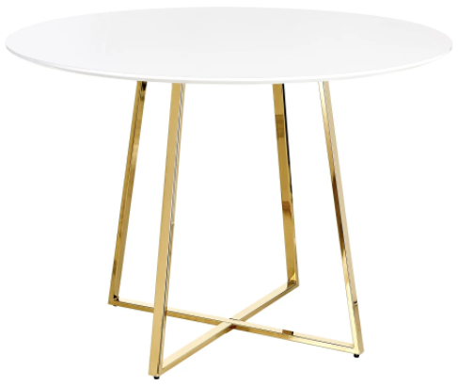
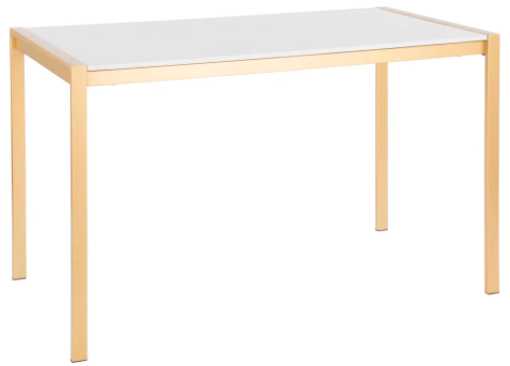
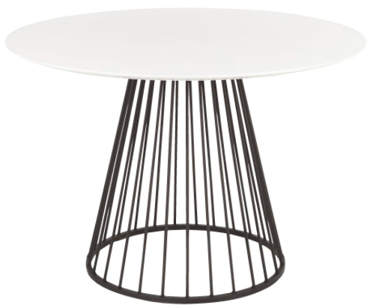
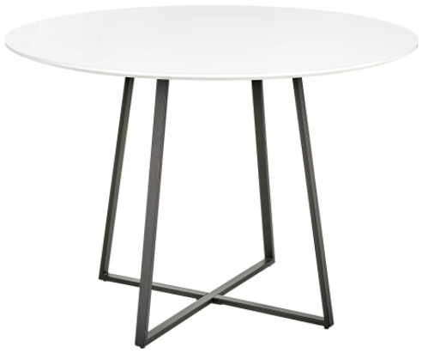
Workspace | Conference
LumiSource Canary Dining Table
LumiSource Cosmo Dining Tables
LumiSource Fuji Industrial Dining Table
Wood and metal table is designed for long-lasting use
Cage-style metal base offers a unique look
Modern table – a must-have for a luxurious display
Elegant round wood white top
Designed to seat up to 6
Weight capacity tested to support 100 lbs.
Assembly required
Dimensions: 29.5”H x 43.5”W x 43.5”D
Product # 6311339 | White/Gold
Product # 3878185 | White/Black
Wood and metal table is designed for long-lasting use
Unique style that will impress your guests
Modern table – a must-have for a luxurious display
Elegant round wood white top
Designed to seat up to 6
Weight capacity tested to support 100 lbs.
Assembly required
Dimensions: 30.25”H x 43.5”W x 43.5”D
Product # 2081824 | White/Gold
Product # 7180580 | White/Black
Ideal for any kitchen or breakroom space
Table is designed for long-lasting use
Industrial style that will impress your guests
White marble tabletop sits atop gold metal frame
Strong metal frame
Sturdy tabletop is easy to clean
Assembly required
Dimensions: 29.75”H x 50.25”W x 27.75”D
Product # 7786757 | White/Gold
Product # 7180580 | White/Black

Slide 14
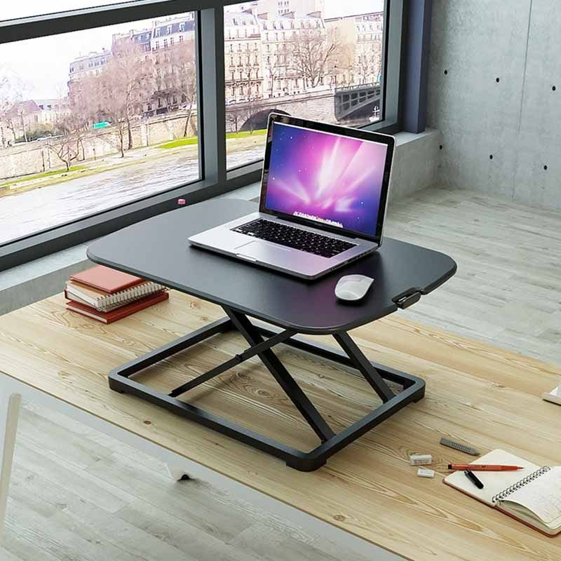
SitStand

Slide 15
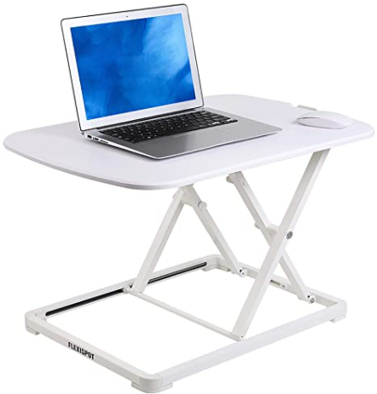
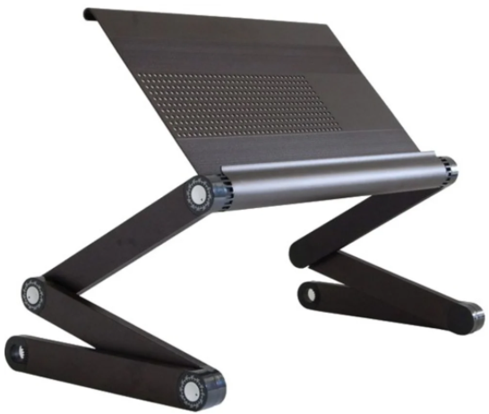
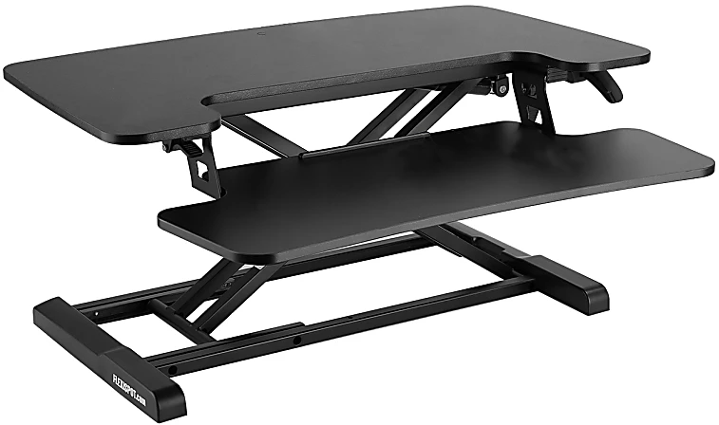

Workspace | Laptop/Desk Risers
FlexiSpot GoRiser ML2W Sit-Stand Converter
WorkEz Executive Adjustable Aluminum
Laptop Stand & Lap Desk
FlexiSpot M732 Metal Height-Adjustable
Sit-Stand Desk Converter
Create a comfortable workspace
Made of sturdy plastic construction
Adjust the height of your workspace
Wide platform to hold a laptop up to 34”
Pneumatic lift to adjust the height
Save time – no assembly required
Overall Dimensions: 34"H x 26.9"W x 19"D
Weight capacity tested to support 17 lbs
Product # 6314845 | White
Product # 5182287 | Black
Improve posture, health & comfort when computing
Luxurious anodized aluminum panel for larger laptops
Adjustable height with tilting panel to reduce eye strain
Compact, closes flat, fast and easy to use
Simple effective adjustable height & angle laptop riser
Dissipates heat to cool laptops – no fans needed
Overall Dimensions: 18”W x 11"D Panel x 3” to 21”H
Lap Desk, Laptop Riser, Tablet Stand, Monitor Stand
Product # 3104857 | Black
Steel frame construction offers durability
Accommodates monitors up to 34" or two 24" monitors
Adjustable desk riser features a 28-7/16" keyboard tray
Cord management maintains a clutter-free workspace
Adjusts from 4.75" to 19.75“h with pneumatic gas-lift
Weight capacity tested to support 37.4 lbs.
Assembly required
Overall Dimensions: 19.75"H x 31.5"W x 16.5"D
Product # 4336339 | Black

Slide 16

Lighting

Slide 17





Workspace | Desk/Task Lamp
Bostitch® Wireless Charging Triangle Adjustable
LED Desk Lamp, 25-5/16"H
LumiSource Darby
Table Lamp, 15-1/2"H
Adesso® ADS360 Crane
LED Desk Lamp, 32-1/2"H
Durable metal and plastic construction.
Swiveling lamp head folds 180° and rotates 90°
Adjustable color temperature modes from warm to cool
5 brightness levels to choose from
Flicker-free LEDs don’t create glare
Memory function remembers your last settings
Wireless charging pad/2 USB ports charge devices
Weighted base keeps the lamp stable
Product # 9250114 | Gold/Gold & White Base
Polyurethane seat and bonded leather back
Creates a comfortable sitting area
Strong metal frame with a beautiful, powder-coated finish
Durable fabric and sturdy powder-coated metal frame
Button-tufted seat & back add a touch of modern style
Assembly required
Overall Dimensions: 32 1/2"H x 27"W x 33"D
Weight capacity tested to support 250 lbs
Product # 6831467 | Gold
Product # 8478380 | Black Shade/Black & Gold Base
Flexible light with a long arm adjusts in height and rotation
Metal base with a hidden spring to allow optimal balance
Powerful energy-efficient 5W LED bulb rated to 30,000 hrs.
Height adjusts from 21" to 32-1/2"
4-way touch dimmer switch located at the end of the shade
Brushed gold accents provide an elegant touch
Shade measures 4"H x 1-1/4"D
ETL Listed
Product # 6486856 | Brushed Gold

Slide 18







Workspace | Table/Floor Lamp
Simple Designs Tapered Table Lamp, 21"H
LumiSource Puck Table Lamp, 17-3/4"H
LumiSource Trophy Table Lamp, 26-1/2"H &
LumiSource Salon Contemporary Floor Lamp
Add style and ambient lighting to your space
Tapered table lamp
Durable base accented by drum shade
Metal base with 5 ft cord
Stylish fabric drum shade
Requires a 40W medium type A base bulb (not included)
Pull chain on/off switch for easy use
Overall Dimensions: 21”H x 8”W x 8”D
Product # 8415349 | Black Shade/Gold Base
Product # 9905238 | White Shade/Gold Base
Rotating shade to direct 25W bulb exactly where needed
Durable steel base
Stylish metal drum shade
Requires a 25W bulb (not included)
In-line switch offers easy on/off access
Weighted base keeps lights stable
UL listed – some assembly required
Overall Dimensions: 17.75”H x 6.25”W x 9.5”D
Product # 9029175 | Black Shade/Gold Base
Product # 3942809 | White Shade/Gold Base
Add stylish ambient light to your space
Elegant pull cords control dual 60W bulbs
Durable steel base
Stylish fabric drum shade
Requires 2 total 60W bulbs (no included)
Dual pull cords offer easy on/off access
Weighted base keeps lighting stable
UL listed – some assembly required
Product # 5313749 | Black Shade/Gold Base
Product # 6021857 | Black & White Shade/Black Base
Product # 2258222 | White & Gold Shade/Black Base

Slide 19

Storage

Slide 20




Workspace | Storage
Lorell® Fortress 3-Shelf Steel Storage Cabinet
Lorell® Fortress 5-Shelf Steel Storage Cabinet
Lorell™ Riveted Storage Shelving, 5-Shelf
Durable welded-steel construction with powder-coat finish
3-point recessed locking handle with keys for security
2 shelves adjust in 2" increments - bottom shelf is fixed
Each shelf holds up to 180 lbs evenly distributed.
3 sets of hinges per door for a easy, smooth opening
Meets/exceeds ANSI/BIFMA performance standards
Fully assembled – just add the hardware
Overall Dimensions: 42”H x 36”D x 18”D
Product # 344599 | Black
Durable welded-steel construction with powder-coat finish
3-point recessed locking handle with keys for security
2 shelves adjust in 2" increments - bottom shelf is fixed
Each shelf holds up to 180 lbs evenly distributed.
3 sets of hinges per door for a easy, smooth opening
Meets/exceeds ANSI/BIFMA performance standards
Fully assembled – just add the hardware
Overall Dimensions: 72”H x 36”W x 18” or 24”D
Product # 344635 | 18” Deep | Black
Product # 972068 | 24” Deep | Black
Great for storing heavier equipment and supplies
5 shelves provide ample space
Steel frame and laminate shelving for lasting strength
Supports up to 3,200 lbs. evenly distributed
Eco-conscious choice
Recycled content
Assembly required
Overall Dimensions: 72”H
Product # 5827964 | 36”W x 18”D | Black
Product # 5848004 | 48”W x 18”D | Black
Product # 9908431 | 48”W x 24”D | Black

Slide 21

Outdoors

Slide 22



Workplace | Seating
Safco CoGo™ Indoor/Outdoor Bench with Back
Safco CoGo™ Indoor/Outdoor Round Table
Safco CoGo™ Steel Seat Stacking Chair
Curved back rest with open-slat design for breathability
Rugged powder-coat steel protects against nicks/scratches
UV- and weather-resistant construction for outdoor spaces
Sturdy nylon glides protect floors from minor damage
Meets/exceeds ANSI/BIFMA performance standards
Save time – no assembly required
Overall Dimensions: 30"H x 60"W x 25"D.
Weight capacity tested to support 250 lbs.
Product # 213983 | Black
Make the great outdoors even greater with this steel table
Modern table for breakroom, dining area, patio or veranda
The steel frame is power-coated for sustained durability
Powder-coated steel frame repels moisture, heat & stains
Table frame features hooks for purses or backpacks
2-1/4" diameter opening for an umbrella (not included)
Assembly required
Overall Dimensions: 29.5”H x 30” or 36”W x 30” or 36”D
Product # 722388 | 30” Diameter | Black
Product # 170111 | 36” Diameter | Black
Durable, resistant to stains, heat, moisture & rust
Ergonomic curved back for comfort.
Open slat design keeps you cool & dry promoting air flow
Sturdy tubular steel frame stands up to constant use
Nylon glides protect floors from scuffs, snags & scratches
Save time – no assembly required
Overall Dimensions 28.75”H x 18.25“W x 22“D
Weight capacity supports weights of up to 250 lbs
Product # 105524 | Carton of 2 | Black

Slide 23



Workspace | Receptacles
Safco® Canmeleon™ Indoor/Outdoor
Pentagon Receptacle, 30 Gallons
Safco® Canmeleon™ Indoor/Outdoor
Pentagon Receptacle, 45 Gallons
Safco® Canmeleon™ Aggregate Panel
Outdoor Receptacle, Side-Opening, 38 Gallons
Affordable fluted panel design pentagon receptacle
High-density polyethylene with built-in UV inhibitors
Telescoping base hides bag
Uses standard 40 x 48" trash bags
Easily adaptable for anchoring or weighting devices
Top opening 9 ½"
Recessed bottom
Overall Dimensions: 28.75”H x 18.5”W X 18”D
Product # 136818 | Black
Affordable fluted panel design pentagon receptacle
High-density polyethylene with built-in UV inhibitors
Telescoping base hides bag
Uses standard 40 x 48" trash bags
Easily adaptable for anchoring or weighting devices
Top opening 9 ½"
Recessed bottom
Overall Dimensions: 28.75”H x 18.5”W X 18”D
Product # 537263 | Black
Telescoping base hides bag
Attractive design has a recessed bottom
Uses standard 32" x 44" trash bags
Easily adaptable for anchoring or weighting devices
GREENGUARD certified — UL.COM/GG - UL 2818 Ranked in two tiers: Certified and Gold
Made with less harsh chemicals for cleaner substances
Overall Dimensions 39.25”H x 18.25”W x 18.25”D
Product # 169525 | Carton of 2 | Black

Slide 24
Thank you!
Visit us: WorkspaceInteriorsOD.com

