Slide 1
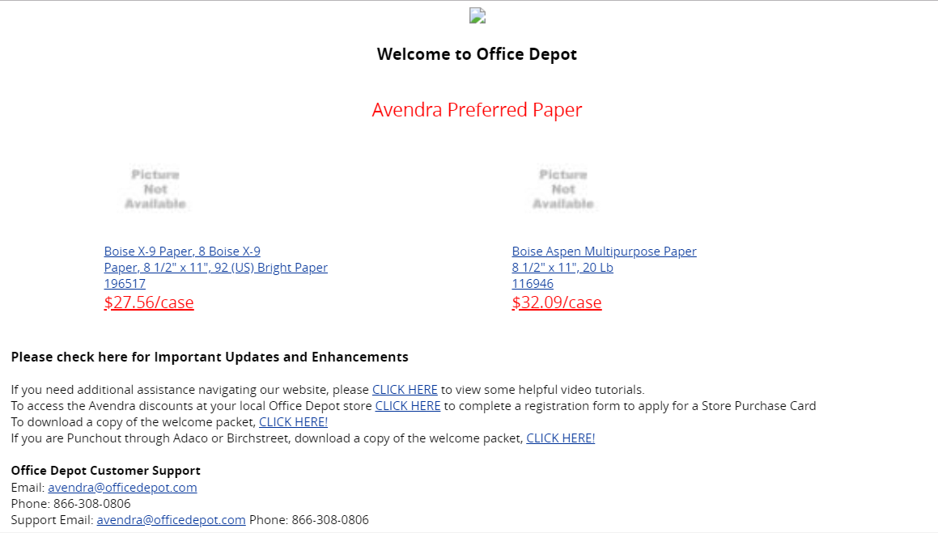
Logo missing
Pics missing
Change to 25.50 CT
Change to 25.50 CT
Update Links:
Shortcut to video tutorials on website
Must keep SPC form link
Add new Welcome Guide (remove punchout version we consolidated into one
Would like to add:
Billing Support:
apbillingsupport@officedepot.com/ 800-721-6592

