Slide 1

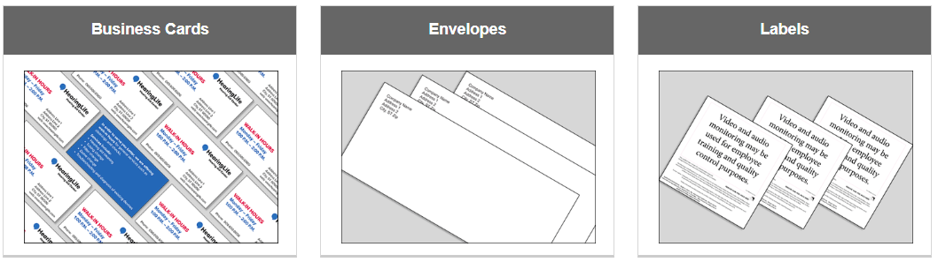
Your Brand Identity Site

Slide 2
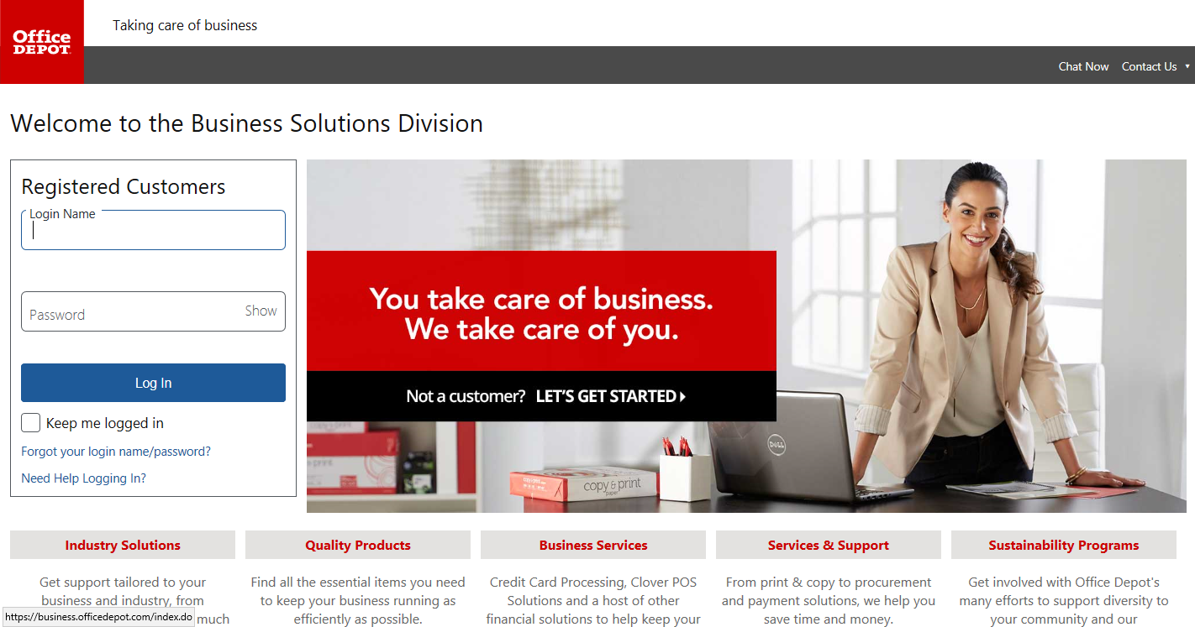
Step 1: Login to your BSD site using your username and password

Slide 3
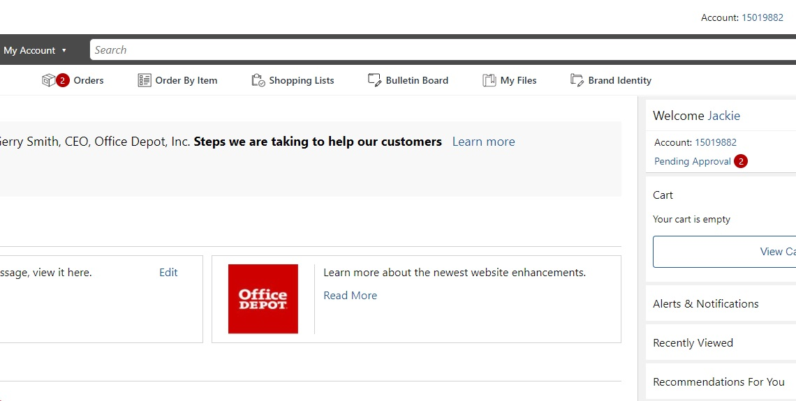
Step 2: Access your Brand Identity Site:
Select Brand Identity

Slide 4
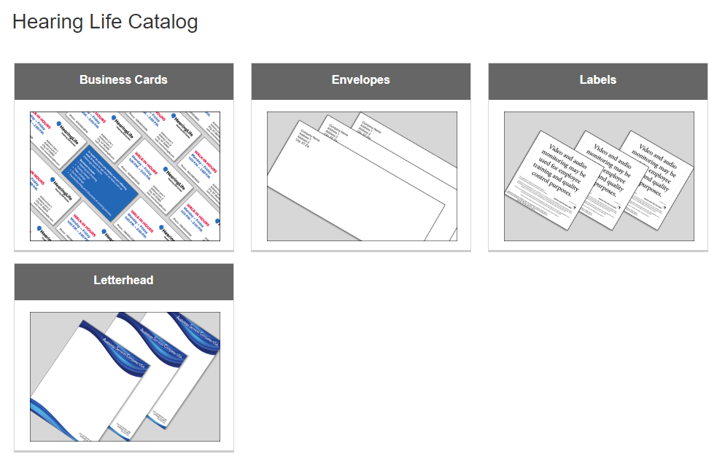
Step 3: Choose Your Category

Slide 5
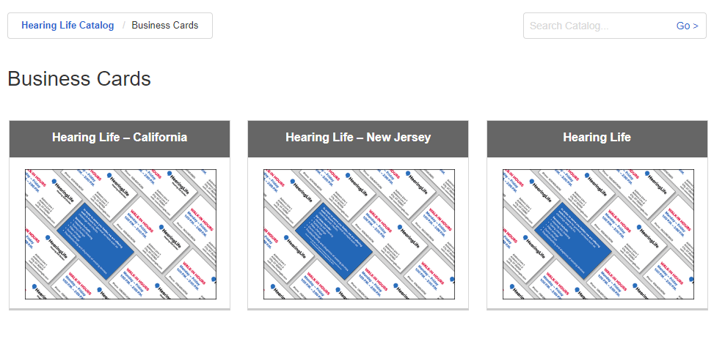
Step 4: Choose Your Sub Category

Slide 6
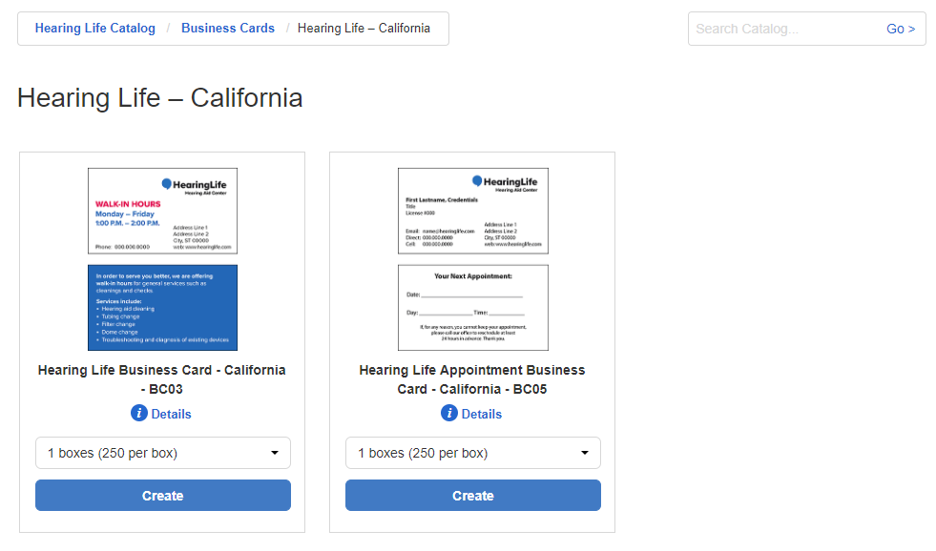
Step 5: Choose your Quantity and Click “Create”
Breadcrumbs for easy navigation
Search Feature
Quantity Drop Down

Slide 7
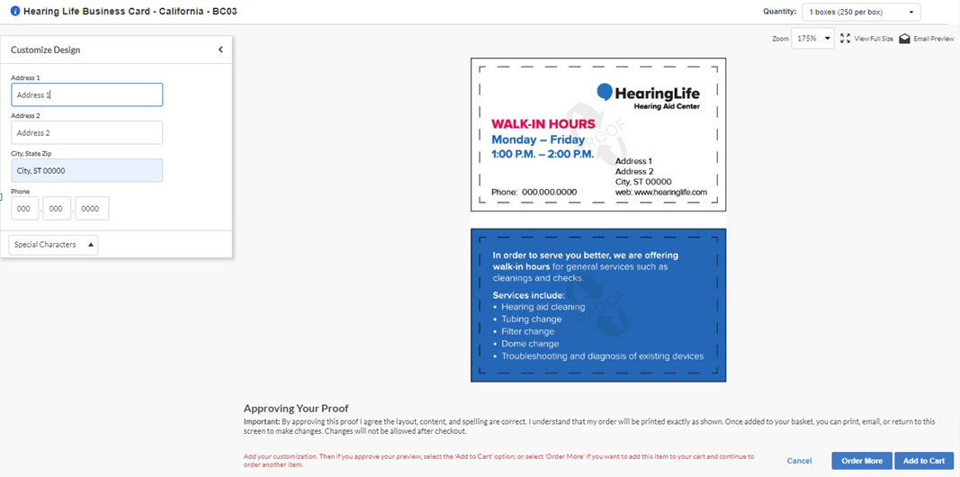
Step 6: Add your customization
Quantity:
Choose quantity in drop down
Zoom Level:
Increase or Decrease Preview Image
Customization:
As you add to the text fields, the product will auto populate for instant product preview
View Full Size Image: To View a PDF Image
Email Preview:
Allows you to email a preview to others
Special Characters:
Allows you to add special characters to text
Click in text field
Click on Special Character box to choose from icons
Add to Cart:
Adds item to cart to proceed to checkout or continue shopping
Order More:
Click to continue shopping for print products

Slide 8
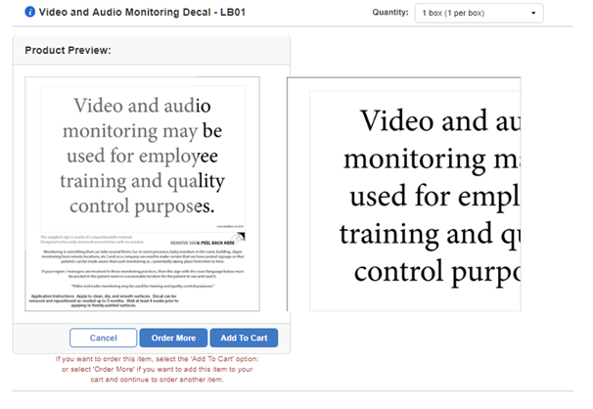
Step 7: Non-Customized Items
Zoom:
Increase Image by Hovering over preview

Slide 9
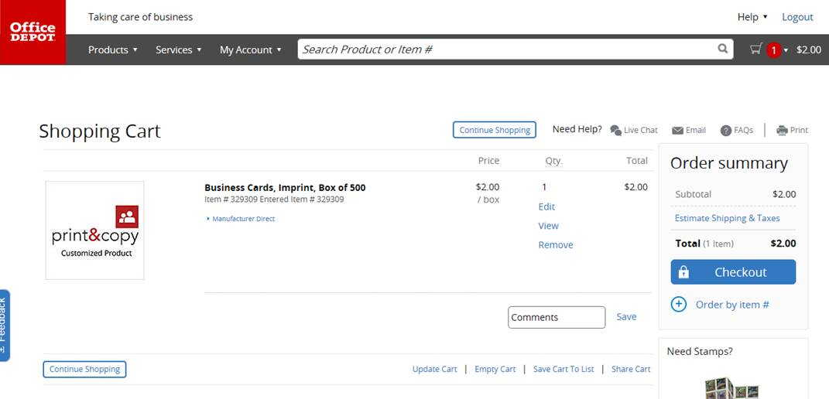
Step 8: When finished ordering, select “Checkout” to enter billing and shipping data
Please review your information. Your order will be printed exactly as shown so once submitted, your order cannot be changed or cancelled.

