Slide 1

F
Hearinglife
My Files User Guide

Slide 2
Key Contacts
Print Support:
Phone - 1-855-302-8768
Email: cpd.customeronlinesupport@officedepot.com
Account Managers:
Jackie Paskow – Jackie.Paskow@officedepot.com
Hearinglife Contacts:
Krystle DaSilva –ksil@hearinglife.com
Support Inbox supportservices@hearinglife.com

Slide 3
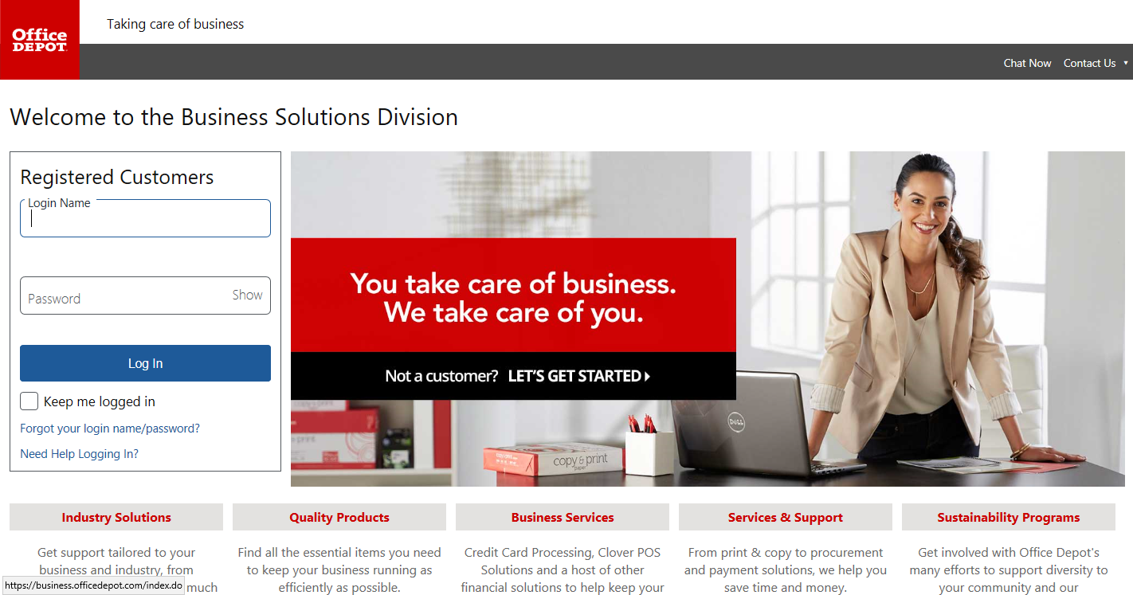
Step 1: Login to your BSD site using your username and password
Click Log In

Slide 4
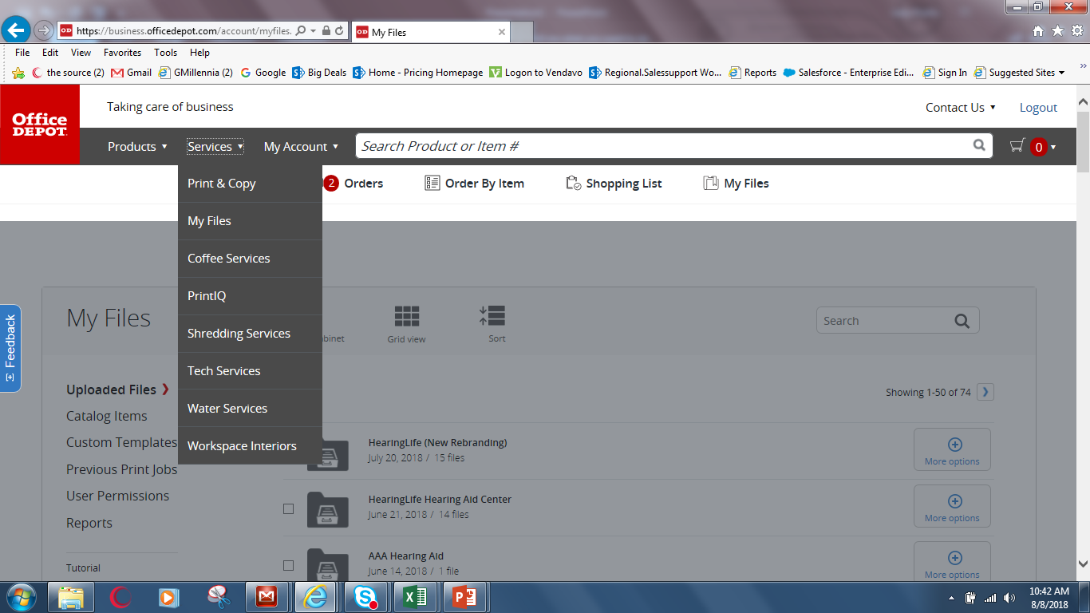
Location of MyFiles
Click on my Files

Slide 5
Or you can find My Files by clicking on Services/ MyFiles
Click on Services then My Files

Slide 6
Hearinglife & Shared Documents Document folder
Double click folder

Slide 7
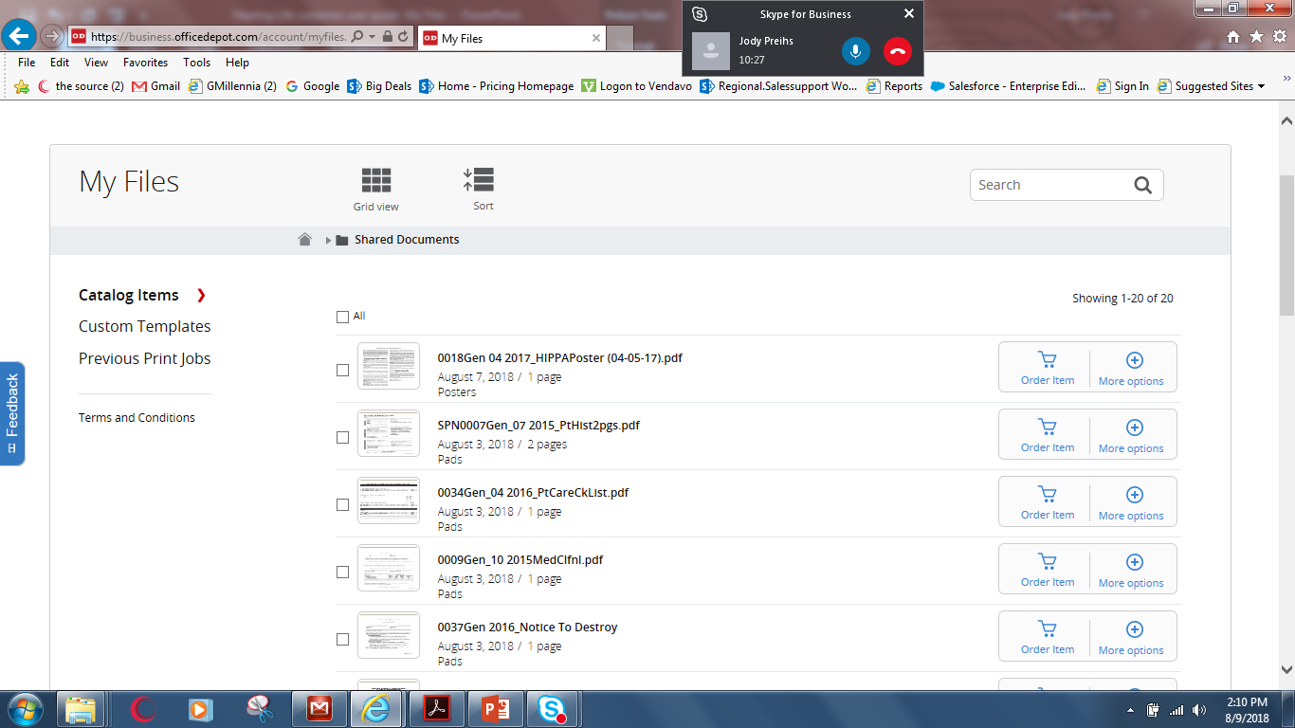
How to Order from Hearinglife & Shared Documents
Click on more options
Order item

Slide 8
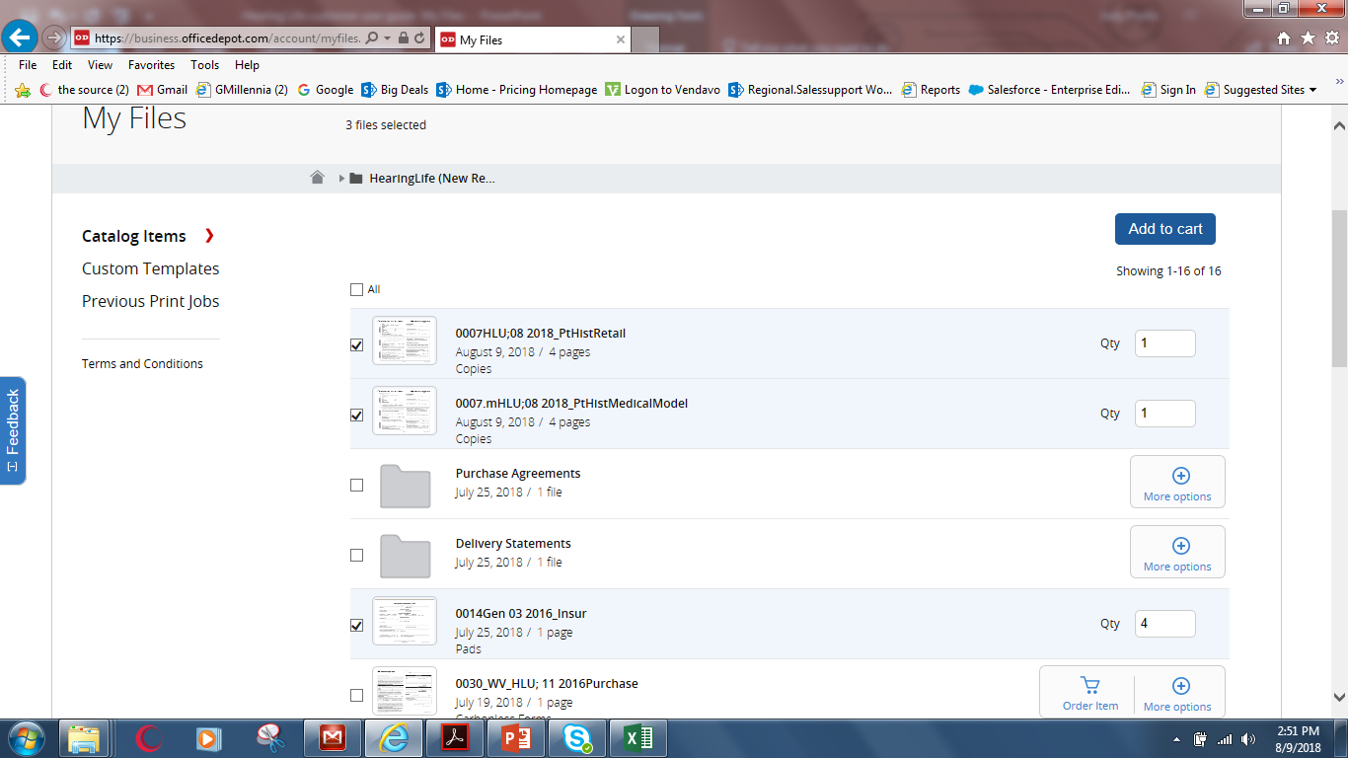
You can order more than one item
Check the box and change quantity if needed add to cart.
Check to order item

Slide 9
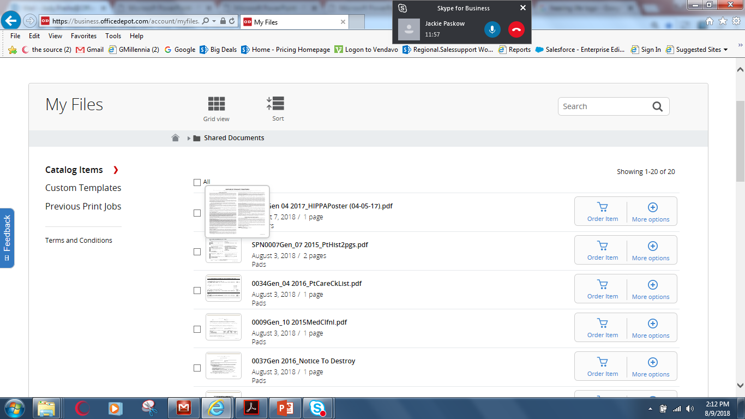
How to Preview Item
If you want to see a preview of the item click on more options

Slide 10
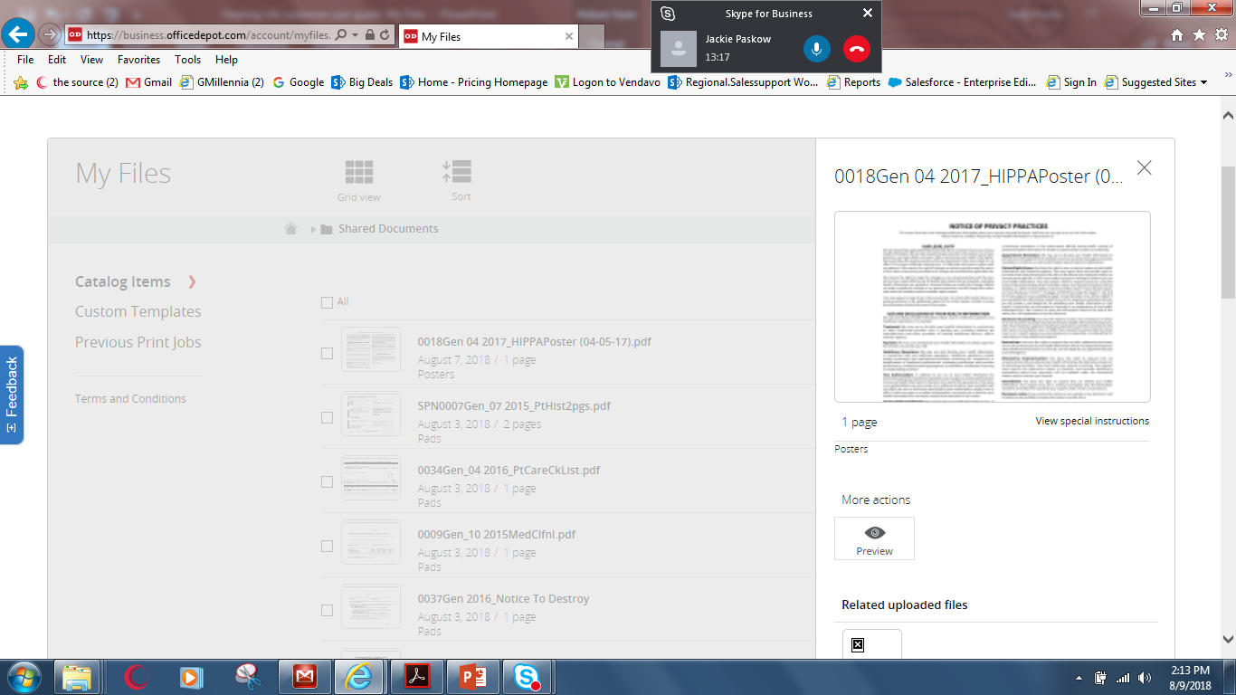
Preview of item

Slide 11
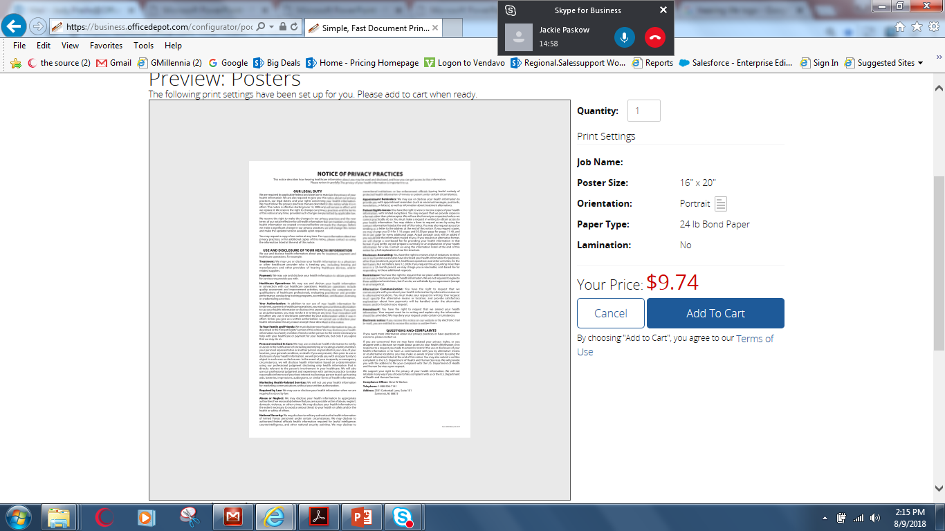
Add to cart to place order
Add to cart

Slide 12
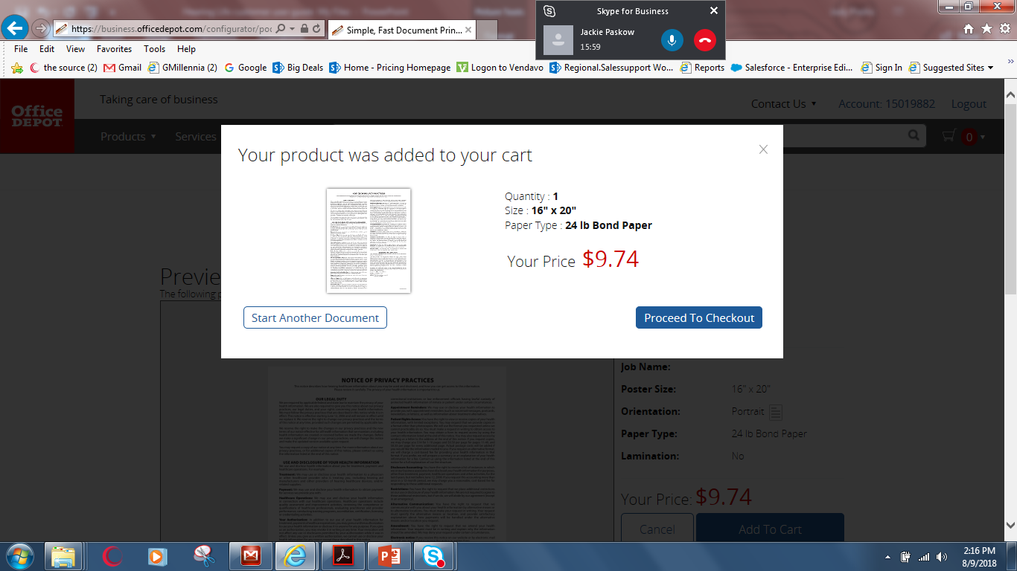
Confirmation that item was added to cart

Slide 13
Please review your information. Your order will be printed exactly as shown so once submitted, your order cannot be changed or cancelled.

