Slide 1
How to Order Alcoa Stationery (U.S.)
Oracle iProcurement → Alcoa Buy → Office Depot
Published February 2018

Slide 2
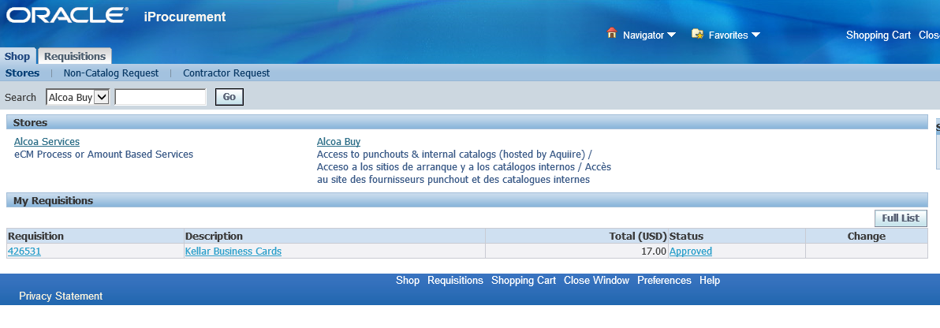
Step 1
Access iProcurement through Oracle and enter Alcoa Buy

Slide 3
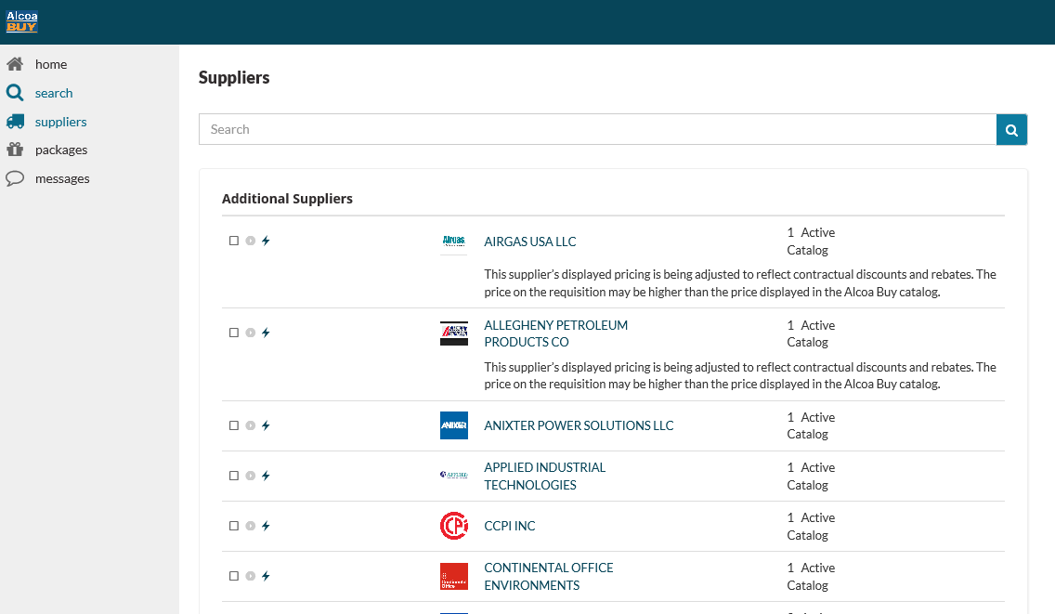
Step 2
From Alcoa Buy, click “Suppliers”

Slide 4

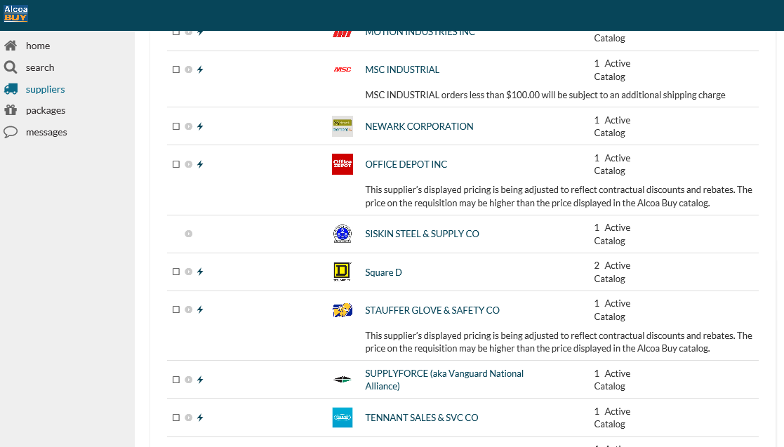
Step 3
Under “Suppliers”, scroll down to Office Depot and select the “ ” icon

Slide 5
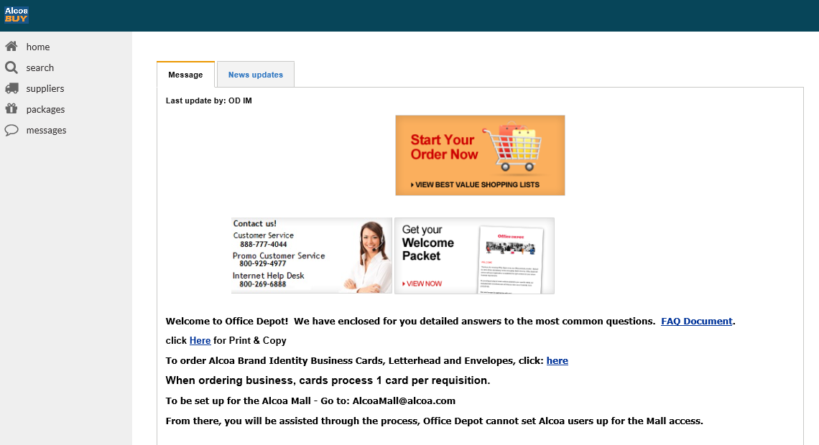
Step 4
From the Office Depot catalog homepage, scroll down to “Alcoa Brand Identity Business Cards, Letterhead and Envelopes” and click “here”

Slide 6
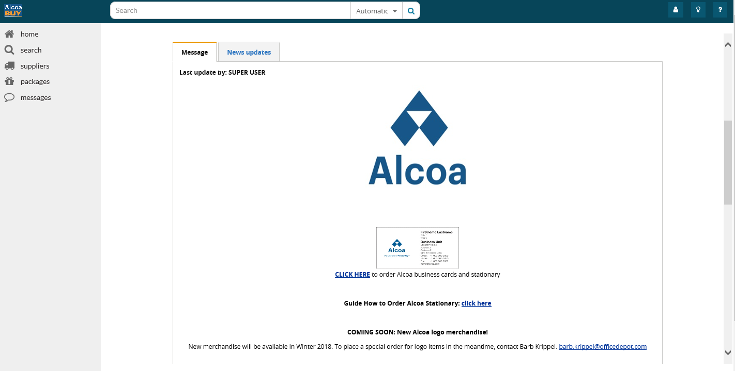
Step 4
From the Office Depot catalog homepage, scroll down to “Alcoa Brand Identity Business Cards, Letterhead and Envelopes” and click “here”

Slide 7
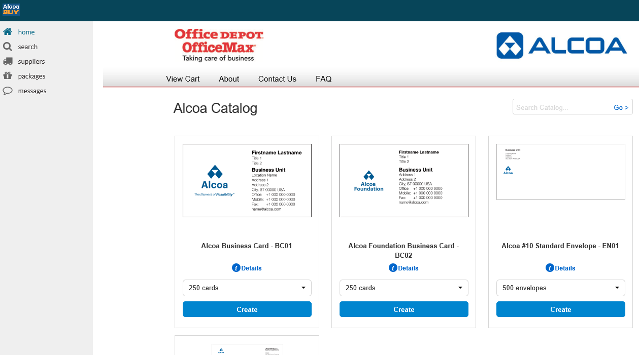
Step 5
Select the desired amount & type of Alcoa stationery and click “Create”

Slide 8
Help Chain Contact Information
Technical Help Chain: GPP@alcoa.com
General Questions: AlcoaBuyMailbox@alcoa.com

