Slide 1
eCommerce 101

Slide 2
Direct Web vs 3rd Party
Direct web:
  Customer maintains user information on BSD site
  Checkout
  Dashboard & Bill Management
  Implementation Team handles large new setups and migrations
  Office Depot billing options
3rd Party:
  One system/login for all vendors
  Customer maintains user information within 3rd party system and is often integrated with HR & Accounting data
  Integration=Commitment/Entanglement/Exclusivity for office supplies
  Using OD for catalog to shop and fill cart (punchout/hosted)
  PO’s are transmitted electronically to OD
  SFDC Ecommerce Field Support Request so EC Consultant can be assigned who will request EC Analyst

Slide 3
Types of Integrations
EDI or Electronic Data Interchange
&
cXML or commerce Xtensible Markup Language
XML or Xtensible Markup Language
xCBL or XML Common Business Library
OCI or Open Catalog Interface (Punchout Only)

Slide 4
Examples of 3rd Party Platforms
EDI = GHX & DSSI
cXML= Coupa, SAP/Ariba, Skyward, Jaggaer (formerly SciQuest), eSchool Mall, Workday, Zycus, Basware, Point Purchasing, Procurement Partners, Perfect Commerce, Sungard, Epylon, Escape Technologies, Ops Technology, Lawson, Peoplesoft
Industry focused:
Education=Jaggaer(SciQuest), Escape Technologies, eSchool Mall, Skyward, Sungard
Property Management=Ops Technology
Hospitals & Manufacturing=GHX, Vizient/MedAssets,
Senior Living Services = DSSI

Slide 5
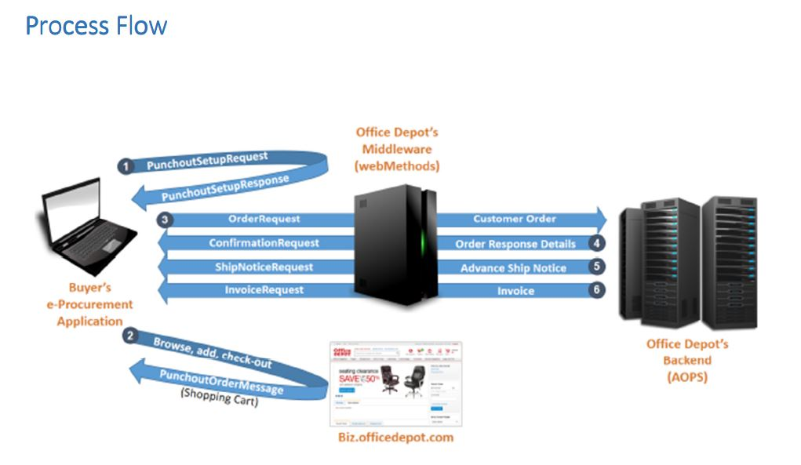
3rd Party Process flow from cXML doc

Slide 6
Timeframe
A typical integration takes 45 - 55 days
A new account is needed if we have a current customer placing orders directly on our website. The main reasons for this are:
  Direct web account requirements differ from 3rd party-PO field is Required all on 3rd party accounts
  Don’t want to affect users with new requirements
  If we are integrating Invoicing with the 3rd party any orders that aren’t generated from the 3rd party system the corresponding invoices will reject and possibly not get paid
Some integrations are what we call “Plug & Play” which means we can use standard PO and Invoice mapping. These projects can be completed in three weeks which includes testing.

Slide 7
Transactions
Catalog>punchout, hosted catalog (primarily for EDI), direct web
Purchase Order-cXML or EDI=850
Purchase Order Confirmation-cXML or EDI=855
Advanced Shipment Notice-cXML or EDI=856
Invoice-cXML or EDI=810

Slide 8
Customer/3rd Party Calls
Understand and keep project moving timely:
Project scope
3rd Party system
Key resources from all companies
Data requirements
Customer timeline
Discuss technical setup
Testing
Gather information so Customer Service can support going forward (Fact Sheet)

Slide 9
Resources
OD Team:
Account Manager
Implementation
EC Consultant
EC Analyst
DSM
Customer Team:
Procurement Manager
Accounts Payable
Ecommerce or Integration specialist
3rd Party Team
Integration Specialist

Slide 10
Catalogs
Types: Standard Punchout, Level II Punchout, Hosted & Direct Web
Standard Punchout (Preferred by Office Depot)
User Level or Account Level
  User Level-user punches out and has personal shopping lists and their own order history. Requires a unique identifier>Email address or employee # to setup. Best customer experience!!
  Account Level-user sees all shopping lists and all orders

Slide 11
Catalogs Cont’d
Level II Punchout-Goal is “One stop shop” for users within 3rd party system
Requires hosted catalog index
  Used so customer can isolate items they want their users to purchase from all vendors.
  User can click on an item and it will punchout to BSD so they can see pictures and description

Slide 12
Catalogs Cont’d
Hosted Catalog-Static catalog which means pricing that will be in the catalog needs to be on a core list and fixed.
  Requires a WRF in Salesforce that involves the Pricing & Catalog Content Departments
  Two week turnaround time
  Updates recommended quarterly
  Account Manager is responsible for initiating WRF’s and letting customer know to expect an update
  Documented process from Elena Nolan

Slide 13
Catalogs Cont’d
Hosted Catalog-Static catalog which means pricing that will be in the catalog needs to be on a core list and fixed.
  Disadvantages are: no access to inventory or detailed product information on website, limited product selection available to customer which reduces revenue and profit margin, not able to take advantage of price updates on off contract items, turnaround time, no options for customizable products such as custom stamps, brand identity or Print on Demand
Direct Web-EDI customers will occasionally use a direct web login to search for product then manually add to their PO

