Slide 1

Bayer Recommended Ergonomic Products
Susan Lerner
201.679.1933
susan.lerner@officedepot.com

Slide 2

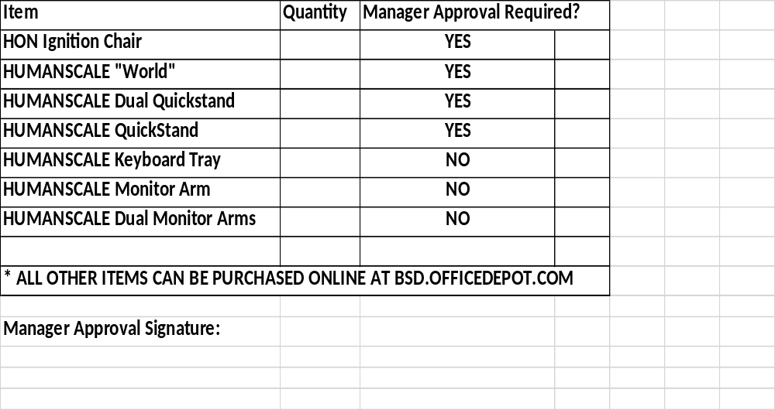
ORDER FORM for susan.lerner@officedepot.com
Name:
Address:
Telephone:
Cost Center
Email:
Account Number (if known):
CWID:

Slide 3

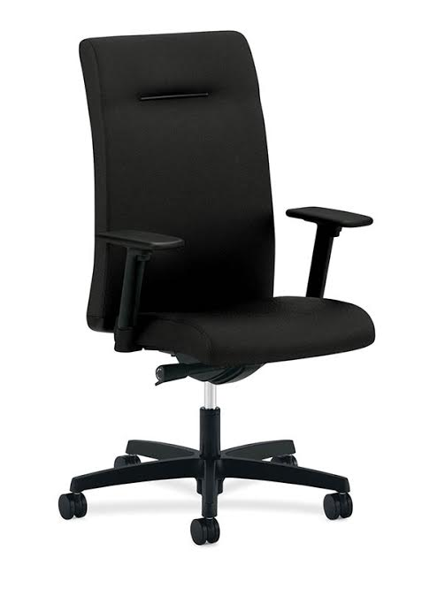
Ergonomic Chair Solutions
Hon “Ignition”
To order, email susan.lerner@officedepot.com with order form attached
Model: HIEH3
High-back chair
Synchro-tilt / Independent back angle
Excellent for time-intensive activities.
All Adjustable Arms
Seat Glide
Warranted for users up to 300 lbs.
Black Upholstery & Frame
Dimensions: 45.5"D x 27.5"W x 49.5"H
$ 395.36
*Freight not included; for home office use only

Slide 4
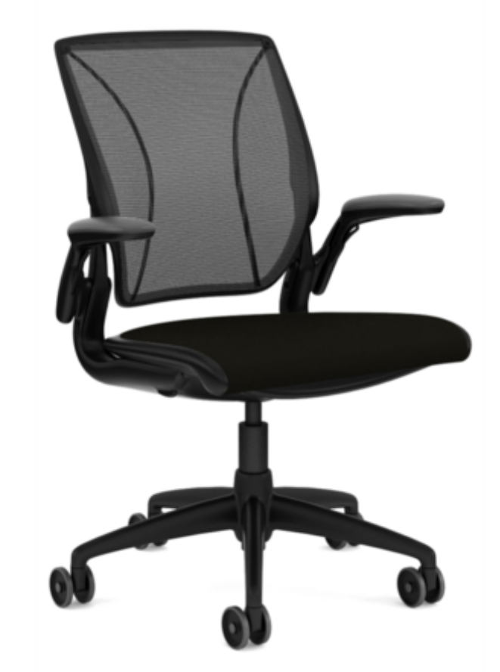
Ergonomic Chair Solutions
Humanscale “World”
To order, email susan.lerner@officedepot.com with order form attached
Model: W11BM11W101
Mechanism Free / Balanced Support
Sitting on Air
Form Sensing Mesh Technology
Tri Panel Low abrasion Mesh Back
Height Adjustable Duron Arms
Seat Glide
Black Upholstery & Frame
Height Adjustable
41.8”x25.75”x18.25”
$ 515.48
*Freight not included; for home office use only

Slide 5
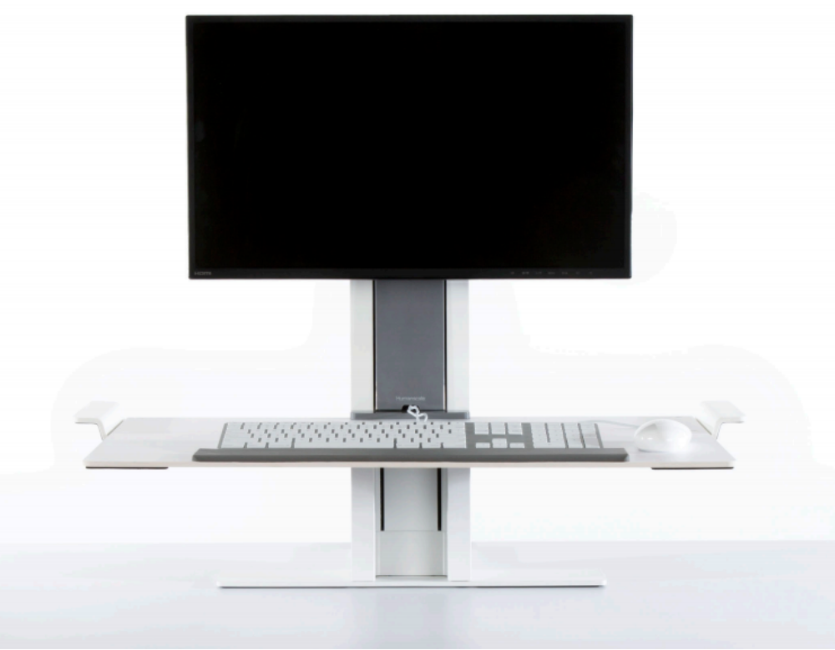
Ergonomic Desk Risers – Sit / Stand Solutions
Humanscale “QuickStand”
To order, email susan.lerner@officedepot.com with order form attached
Model: QSWL30FNN
Dynamic design allows the height-adjustable workstation with Freestanding 30” base to sit on worksurface
Adjustable keyboard platform enables the work surface to move effortlessly to the user’s desired height
Able to accommodate nearly any application
Single Monitor Application
Available in White or Black
*Freight not included *Mgr/ Site Services approval required
$ 534.50

Slide 6
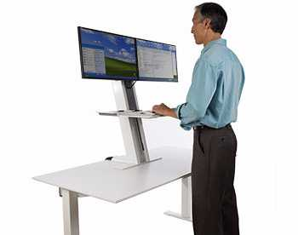
Ergonomic Desk Risers – Sit / Stand Solutions
Humanscale Dual Monitor “QuickStand”
To order, email susan.lerner@officedepot.com with order form attached
Model: QSWC30FNN
Dynamic design allows the height-adjustable workstation with Freestanding 30” base to sit on surface
Adjustable keyboard platform enables the work surface to move effortlessly to the user’s desired height
Able to accommodate nearly any application
Dual Monitor Application
Available in White or Black
$ 609.50
*Freight not included
*Mgr/ Site Services approval required

Slide 7
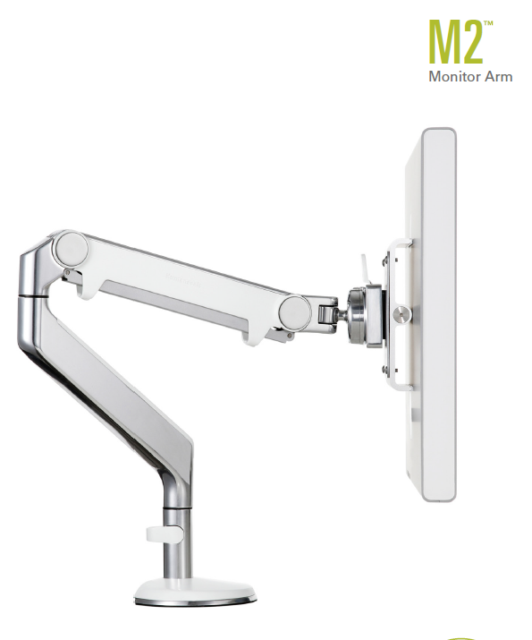
Monitor arms
HumanScale
To order, email susan.lerner@officedepot.com
Model: M2DS1S
Effortless Height and Depth Adjustment
Extension-Spring Technology
Supports Flat panel screens up to 20lbs.
Dual Mount Clamp/Bolt through attachment
Single Monitor Application
Silver with Grey Trim
$ 145.55

Slide 8
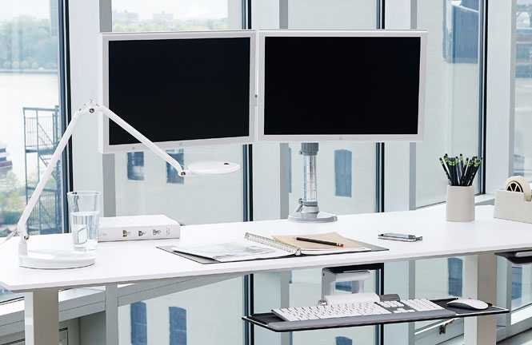
Dual Monitor arms
HumanScale
To order, email susan.lerner@officedepot.com
Model: MF22S22D12
Effortless Height and Depth Adjustment
Extension-Spring Technology
Supports Flat panel screens up to 20lbs. per arm
Dual Mount Clamp/Bolt through attachment
Dual Monitor Application
Silver with Grey Trim
$ 312.01

Slide 9
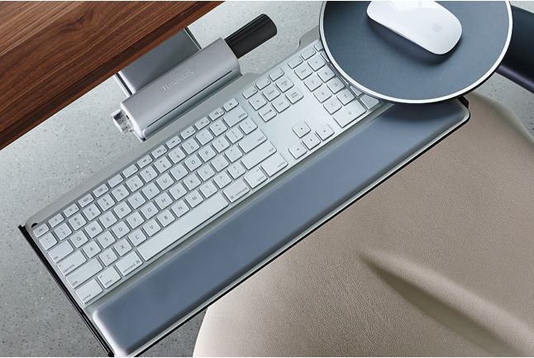
Ergonomic Keyboard Tray
Humanscale
To order, email susan.lerner@officedepot.com
Model: 6G90090
Articulating keyboard tray
Intuitive height adjustment that requires no locks, levers and control and simple Dial-a-tilt positioning.
Ultra thin profiles to offer maximum knee clearance
Platform with non handed Clip Mouse
19” Foam w/ Synthetic Leather Cover Palm Rest
Standard 21.625” Track
Mounts under worksurface
$ 183.27

Slide 10
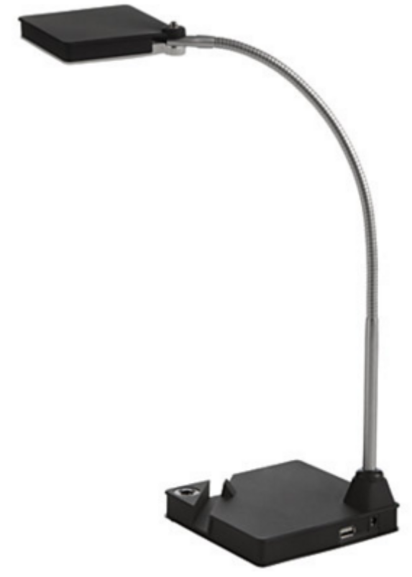
Task Light
Versatile task light focuses the right amount of light just where you need it and offers a smart device slot and USB charging port (at rear of lamp base). Shade bends up to 180 degrees. The lower hinge can bend forward. Light is generated by 8-watt SMD LED module that is irreplaceable. Dimming switch offers three levels of light as well as an on/off function. LED Task Light is made of aluminum and plastic. It includes a DC adapter and a power cord almost 6' long. Lamp is for indoor use only.
To order, log into bsd.officedepot.com and enter SKU #444353
Task Light with USB charging port
$54.99

Slide 11
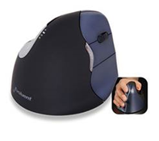
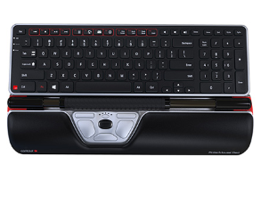
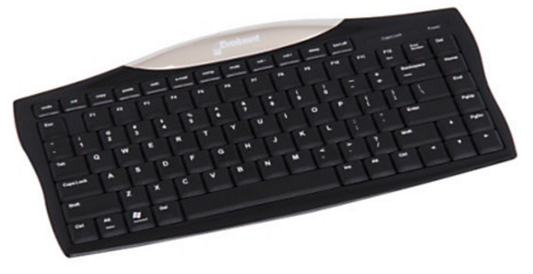
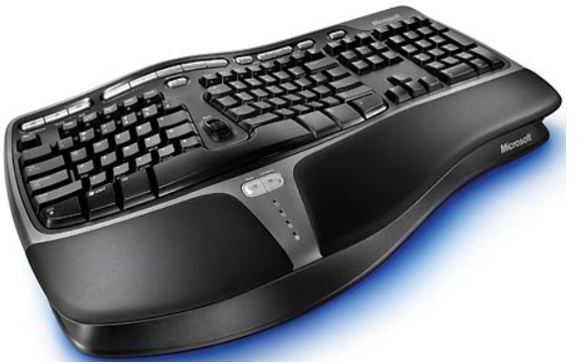
Ergonomic Mice & Keyboards
To order, log into bsd.officedepot.com and enter corresponding SKU number
Evoluent Vertical
Mouse Sku 555106 $88.59
Contour Roller mouse + Keyboard
Special Order
Evoluent
Sku 388937 $67.51
Microsoft keyboard
Sku 283736 $49.72

Slide 12
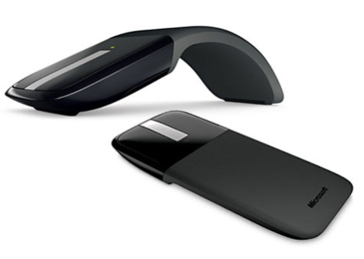
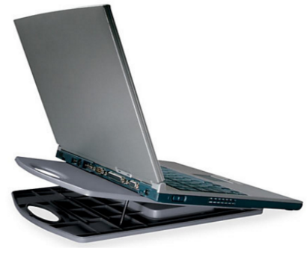
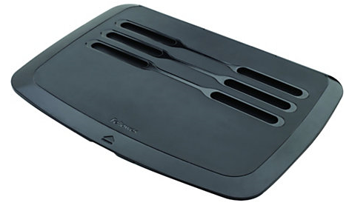
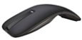
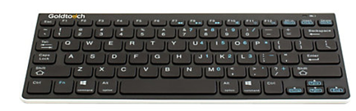
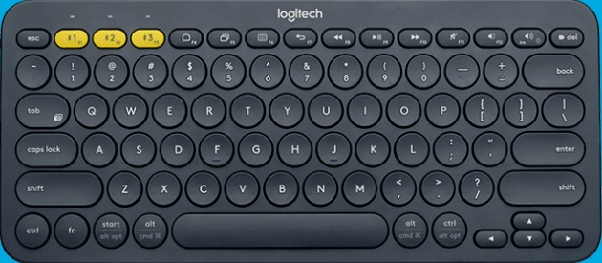
Travel Equipment
To order, log into bsd.officedepot.com and enter corresponding SKU number
Arc Touch Mouse
SKU #856058 $62.99
Portable Notebook Cooling
Stand by Kensington
SKU #154026 $18.28
Laptop Riser, Fellows
SKU #679113 $28.49
Dell Bluetooth Mouse
SKU #860486 $54.99
Goldsmith Compact Keyboard
SKU #753967 $62.33
Compact Keyboard
SKU #471319 $25.24

Slide 13
Questions/ Contact Info
Susan Lerner
Major Account Manager
Office Depot
4 Brighton Road, Ste 400
Clifton, NJ 07012
201-679-1933
susan.lerner@officedepot.com

